Slide 1
SMART PARKING

Slide 2
PHASE 2: INNOVATION
INTEGRATING CAMERA BASED SOLUTION FOR IMAGE PROCESSING
DETECT PARKING SPACE AVAILABILITY

Slide 3
Integrating a camera-based solution for image processing to detect parking space availability represents a cutting-edge approach to addressing the persistent urban challenge of parking management.
This innovative system leverages advanced computer vision techniques and machine learning algorithms to analyze real-time camera feeds from parking lots or urban areas.
By capturing and processing images, this technology can identify vacant and occupied parking spaces, providing invaluable data to both drivers and parking operators.
The key components of such a solution include high-resolution cameras strategically placed to cover the parking area, an image processing pipeline that can detect and track vehicles within the frames, and a robust algorithm to determine the availability status of individual parking spaces.
These algorithms can account for various factors, such as vehicle size, shadows, and even weather conditions, to ensure accurate and reliable results.

Slide 4
The benefits of integrating camera-based image processing for parking space detection are numerous.
For city planners and parking lot operators, it offers real-time insights into occupancy rates, helping optimize resource allocation and improve the overall efficiency of parking facilities.
Drivers, on the other hand, gain access to live parking availability information through mobile apps or signage, reducing the time and frustration associated with searching for parking spots.
This not only enhances the overall convenience of urban life but also contributes to reducing traffic congestion and greenhouse gas emissions by reducing the time spent circling for parking.

Slide 5
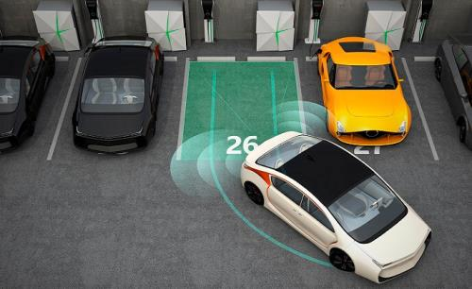
Additionally, the data collected can be used to predict parking demand patterns, optimize pricing strategies, and improve overall urban mobility planning.
In summary, integrating camera-based image processing for parking space detection represents a forward-thinking solution to the challenges of urban parking management.
It leverages technology to enhance the convenience of parking for individuals, optimize resources for operators, and contribute to more sustainable and efficient urban mobility.

Slide 6
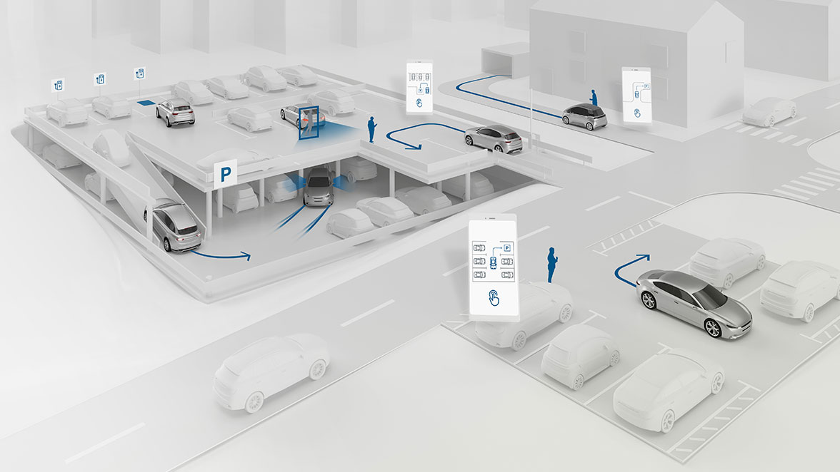
For city planners and parking lot operators, it offers real-time insights into occupancy rates, helping optimize resource allocation and improve the overall efficiency of parking facilities.
Drivers, on the other hand, gain access to live parking availability information through mobile apps or signage, reducing the time and frustration associated with searching for parking spots.

Slide 7
The benefits of integrating camera-based image processing for parking space detection are numerous.
For city planners and parking lot operators, it offers real-time insights into occupancy rates, helping optimize resource allocation and improve the overall efficiency of parking facilities.
Drivers, on the other hand, gain access to live parking availability information through mobile apps or signage, reducing the time and frustration associated with searching for parking spots.
This not only enhances the overall convenience of urban life but also contributes to reducing traffic congestion and greenhouse gas emissions by reducing the time spent circling for parking.

Slide 8
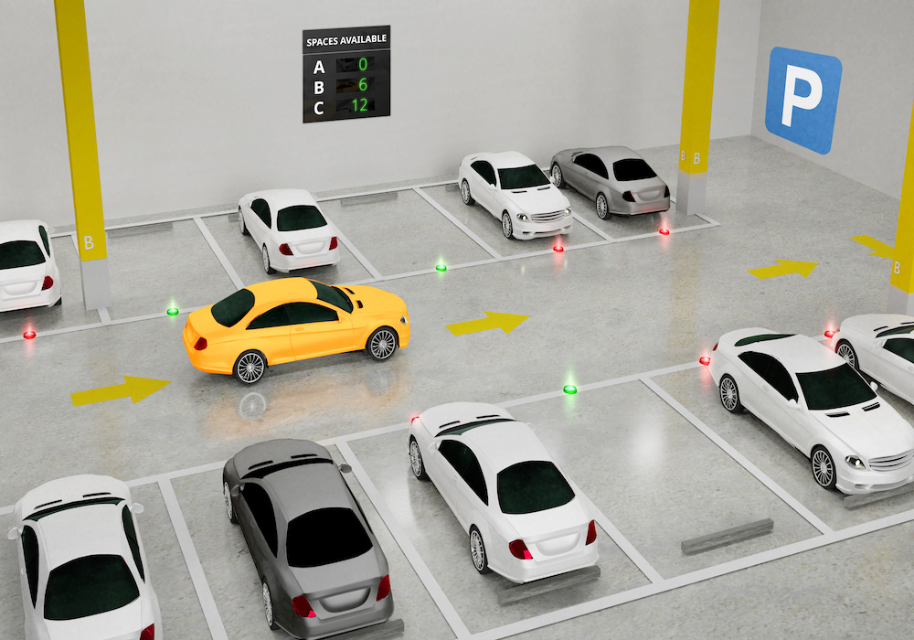
In summary, integrating camera-based image processing for parking space detection represents a forward-thinking solution to the challenges of urban parking management.
As smart cities continue to evolve, such innovations are essential for creating smarter, more livable urban environments.

Slide 9
THESE ARE TOPICS OF PHASE 2: INNOVATION
BY TEAM MATES:
1.Akash G
2.Akash S
3.Arun kumar A
4.Ashika Angel J
5. Deepalakshmi E

